Slide 1

Technology: Java
Farm Management System

Slide 2
INDEX
Abstract
Introduction
Literature review
Existing Method
Drawbacks
Proposed method
Advantages
Implementation
Architecture
Modules

Slide 3
ABSTRACT
The amazing developments in science and technology have raised the bar for human living standards. Without these improvements, the entire planet will be physically congested. Compared to other projects now in existence, this project is innovative in that it simplifies the process of getting farming. Java has been used to implement this project. The project's goal is to create an application software to lessen the human labour involved in keeping track of the farming of different crops consumed by people and getting farming on different ways based on seasonal wise. The fast changing environment, including difficult market conditions and a high exposure to financial risks are major reasons for changing production policy. Farm Management Systems appear to be a powerful tool to deal with the new conditions. However, farmers still rely more on their intuition than on proper management tools, when it comes to running a farm business. Many farmers do not use Farm management for various reasons, like lack of knowledge and the complexity of many available farm managements. In particular for small to medium-sized farms and for multifunctional farms appropriate farm management hardly exist.
Keywords: Farming, Crops, Products , Admin, Customer, Orders etc.

Slide 4
INTRODUCTION
Nowadays people are putting more and more emphasis on quality of life. The food safety concern and attention are also increasing. The dairy products health security as an important part of food safety, has been on the agenda. Therefore, how can guarantee food safety has become an important research subject. Dairy farming has always been a traditional industry, but the industry development is uneven. Large dairy farms purchase foreign equipment and production experience to manage the zap, but due to limits on various aspects of funds, small or remote areas will not be able to introduce advanced equipment, they still adopt the traditional way to zap daily management. This way influence cow production management and technical support, in this context, we urgently need a reliable and advanced management methods to manage the zap.
This paper is organized as follows. In section 2, the Control Scheme And Design Of The System is presented. In section 3, according to the principle of the system, the Overall Design is given. The Hardware Design Of Actuator System is introduced in section 4. And in section5, Software Programming is completed. Finally, our work of this paper is summarized in the last section.

Slide 5
LITERATURE REVIEW
S. No | Journal Type with year | Authors | Title | Outcomes
1 | 1999 | Bryant, L. | Farmers’ usage patterns and impact on the farm management | we have tried to remove the drawbacks. It was found that the human effort is too much in the traditional electric meter reading and efficiency of traditional process is much less than it could be with this new process
2 | 2010 | Grubb, J | A Low Cost Automated Livestock Tracking System | This research will develop and evaluate a prototype data acquisition system for tracking livestock.
3 | 2004 | Cerosaletti, P.E., Fox, D.G., Chase, L.E | Phosphorus Reduction Through Precision Feeding of Dairy Cattle, Journal of Dairy Science | This would slow the rate of phosphorus accumulation in agricultural soils in the Cannonsville Basin
4 | 2001 | Kuhlmann, F., Brodersen | Information technology and farm management | farmers want to increase the economic efficiency of their production and marketing processes by decreasing waste and friction

Slide 6
EXISTING METHOD
People now a days use a manual process for buying products and required things,due to some reasons. They have got used to the manual process and they can go along with it even though there are concerns associated with it. They are reluctant to change their current process since it will be an extra effort. The farm management for a new solution. However, the customers face immense problems with the current procedure of using this manual process to getting formation items.
Dis advantages:
Required Manual efforts
Requires more time

Slide 7
PROPOSED METHOD
To overcome the problem with an existing system, we are implementing an application called farm management system using java. Using this application customers can get all the products information via through his own accounts. After that customer can able to add products to the cart and buy the required things through online.
Advantages:
Manual process not required
Requires less time

Slide 8
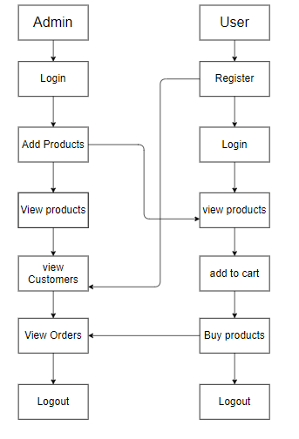
PROPOSED METHOD
Block diagram of proposed method

Slide 9
IMPLEMENTATION
Install the required packages
Defining the problem association.
Runs admin and user modules.

Slide 10
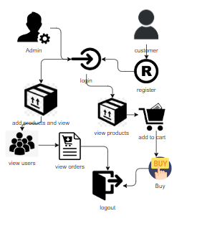
ARCHITECTURE
Architecture diagram of proposed method

Slide 11
SYSTEM REQUIREMENTS
SOFTWARE AND HARDWARE REQUIREMENTS:
Operating system : Windows 7 or 7+
Ram : 8 GB
Hard disc or SSD : More than 500 GB
Processor : Intel 3rd generation or high with 8 GB Ram
Software’s : Java 8 or high version, Eclipse.

Slide 12
MODULES
This project contains four modules as mentioned in below are:
Admin:
Admin must login with valid default credentials, Admin will add the products and he can able to view all added products. He can able to view all the registered customers and admin can maintain the customers , view all the orders ordered by customers
User:
User can register with his required details and must be login with valid credentials. He can able view all the products which are added by admin, add to the cart which are required and buy from cart.

